Slide 1

Predicting Airbnb Rental Prices
Group 6
- Lakshmi Annapoorna Madireddy
- Ravi Bhagwat
- Shailey Rai
- Rishabh Choudhary
- Yixuan Chan

Slide 2
Airbnb hosts are always in the dilemma of determining the optimal rental price for their space. Using the available data, we would like to help Airbnb hosts price their space according to the dynamics of the marketplace to generate maximum revenue.
Problem Statement & Goal

Slide 3
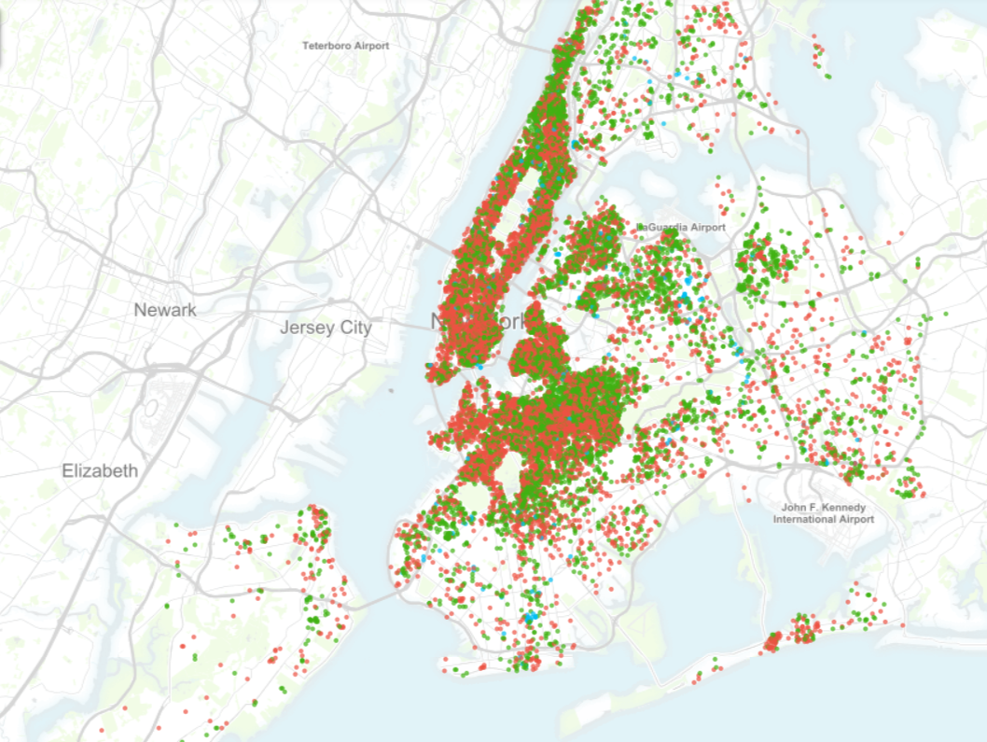
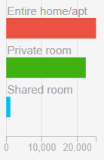
Introduction to Dataset
The dataset is provided by a group named Inside Airbnb which is not associated with Airbnb.
Original dataset had 106 variables which we reduced to 19 variables for our analysis with 51k observations.
We reduced the variables because they wouldn’t help much in the analysis and to make data less cumbersome. Below are some important variables which we think determine the price.
accomodates | the number of guests the rental can accommodate
bedrooms | number of bedrooms included in the rental
bathrooms | number of bathrooms included in the rental
beds | number of beds included in the rental
price | nightly price for the rental
review_scores_rating | score of the rental given along the reviews
Figure: Location of listings using latitude and longitude variables

Slide 4
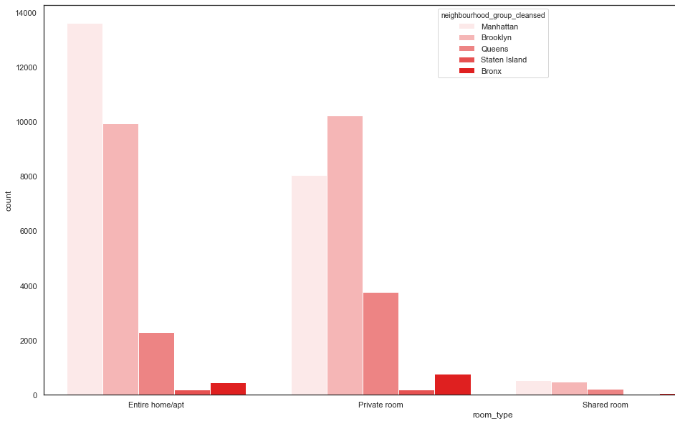
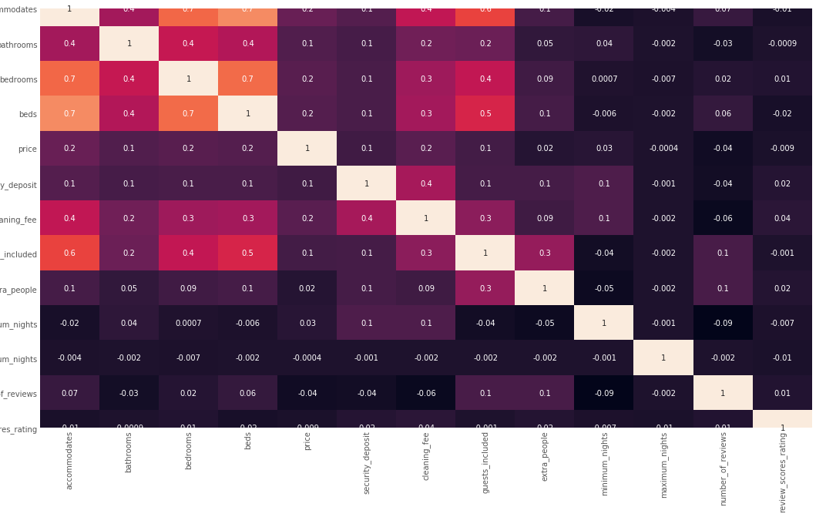
Data Exploration
Countplot to see listings boroughs-wise
Correlation matrix

Slide 5
Data Preprocessing
Understand the shape of the dataset
Check cardinality of categorical variables
Drop variables with high cardinality
Drop numerical variables like longitude and latitude
For data imputation, we find the missing values for each variable
Impute numerical variables using the median method
Impute categorical variables using mode method
Encoding categorical variables using dummy variables
Splitting the data into train and test data and scaling it
Eliminate multi-collinearity and dropping variables with VIF > 2.5

Slide 6
Model Development
We used Random Forest Regression technique to build our prediction model because its predictive performance is good for supervised learning and provides us with feature importance estimate.
Our prediction variable is ‘Price’ hence we keep it in a separate array.
In order to get the least mean absolute error, we tried choosing different number of decision trees to build the model and found MAE to be least for 1000 trees.
Our model came out to be 93.26% accurate with 17 variables.
# of decision trees | Mean absolute error
500 | 73.62
750 | 73.56
1000 | 73.46
1500 | 73.50

Slide 7
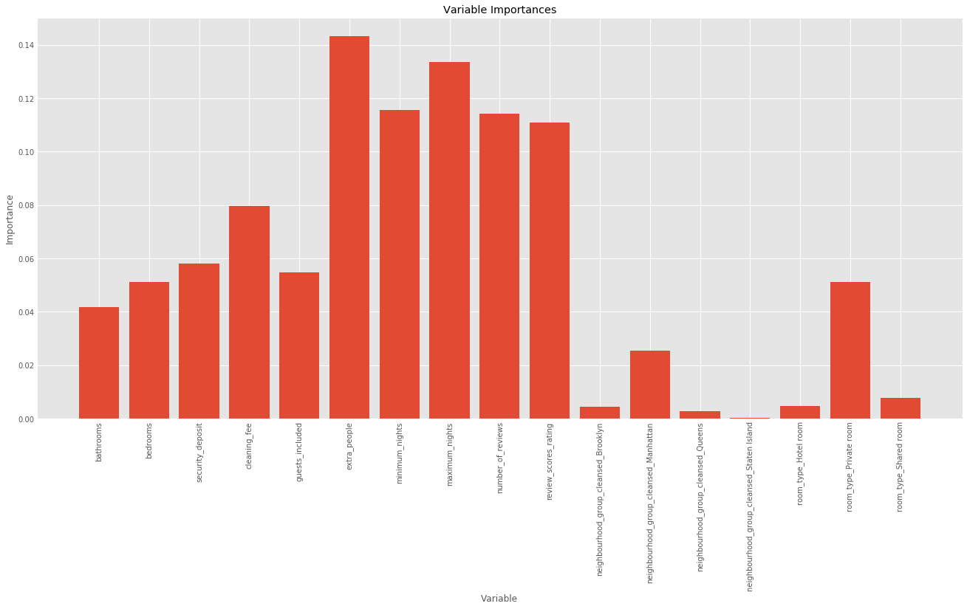
Improving Model
Using variable importance feature in Random Forest we reduced the number of variables in our model from 17 to 10. Any variable having importance figure less then 0.05 was dropped.
New model metrics
Mean absolute error: 82.9 degrees
Accuracy: 94.27%

Slide 8
Limitations
The dataset if only for New York State, hence the model could not be used for any other place.
We choose limited variables from the original dataset on our understanding, however, there is possibility that the dropped variables could be more effective in building the model.
We choose Random Forest as our prediction technique. There are high chances of other techniques giving better results

Slide 9
Conclusion
Our goal of helping Airbnb hosts in deciding the prices of their space was achieved after running our analysis and model. We were able to predict the prices with approx. 95% accuracy and these predicted prices if used in real world scenario may help the hosts in hitting the sweet spot with the rental prices to generate more income.
Additionally, with this project, we learned to develop a prediction model in Python and how to use it to help businesses grow using Analytics.
Thanks to our professor Ms. Marina Johnson for giving us with this opportunity.

Slide 10
Thank You

